Slide 1



Smart Parking Management System
(Intelligent and Automated Parking Lot Management Solution)
Presented By
1.Shivansh Vashisth
2.Krish Jayendrakumar Patel
3.Yashraj Shriram Soni
4.Sahid Alam

Slide 2



What are the objectives of this project??
To develop an intelligent and automated parking lot system that optimizes space usage.
To provide real-time parking slot availability and allow users to reserve slots seamlessly.
To automate the billing system with dynamic pricing and ensure a secure entry/exit process.
To integrate eco-friendly features like EV Charging Stations and offer subscription plans.

Slide 3

Real-time monitoring of available parking slots.
Parking slot assignment based on vehicle type (Car, Bike, Truck, EV).
Reservation system with advance booking facility.
Automated billing system with dynamic pricing (hourly, daily, surge rates).
Entry/Exit tracking through RFID, QR code scanning, and License Plate Recognition.
EV Charging station integration with automated billing.
Monthly and annual subscription support for regular users.
Key Features

Slide 4


Java concepts used
Abstract Classes and Interfaces
Overloading and Overriding
Exception Handling
File Handling (FileReader, FileWriter)
Collections (ArrayList, HashMap)
Inheritance
Other Tools:
Scanner for user inputs
Wrapper classes (Integer, Double)

Slide 5



System Architecture
User Module: Interface for users to reserve slots and make payments.
Parking Management Module: Manages slot availability, vehicle assignment, and EV stations.
Reservation and Billing Module: Handles reservations, pricing calculations, and payment processing.
Security Module: Records vehicle entry and exit logs via RFID, QR Codes, and License Plate Recognition.
Administration Module: Allows system monitoring and analytics.

Slide 6
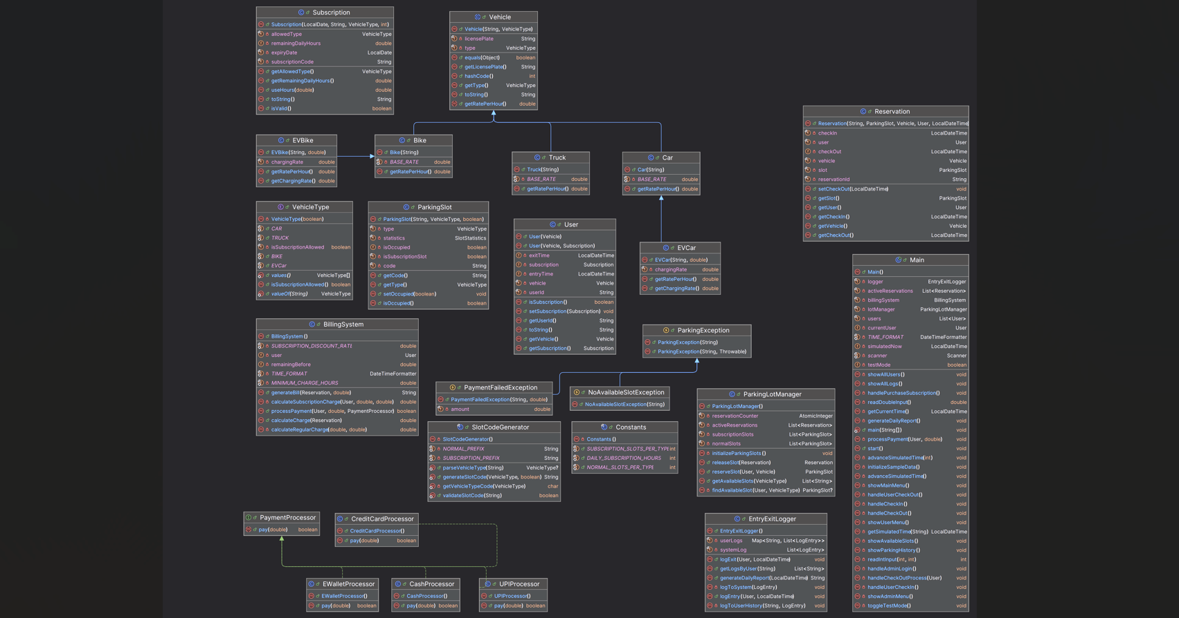
UML DIAGRAM

Slide 7


JAVA class files MADE for project
1.Main class file
2.core files
- ParkingLotManager
- ParkingSlot
- Reservation
3.exception files
- NoAvailableSlotException
- ParkingException
- PaymentFailedException
4.logging file
- EntryExitLogger
5.user files
- Subscription
- User

Slide 8


6.payment files
- BillingSystem
- CashProcessor
- CreditCardProcessor
- EWalletProcessor
- PaymentProcessor
- UPIProcessor
7.util files
- Constants
- SlotCodeGenerator
8.vehicles files
- Bike
- Car
- EVBike
- EVCar
- Truck
- Vehicle
- VehicleType

Slide 9
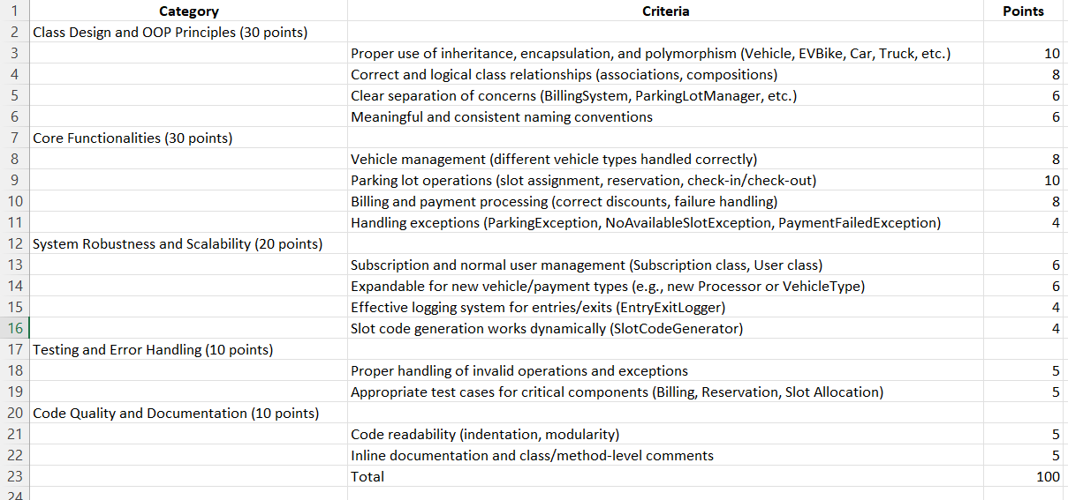
RUBRICS

Slide 10
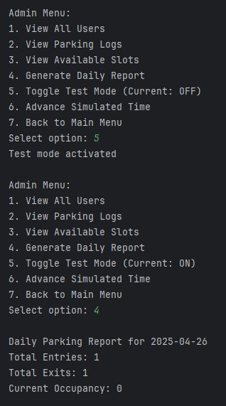
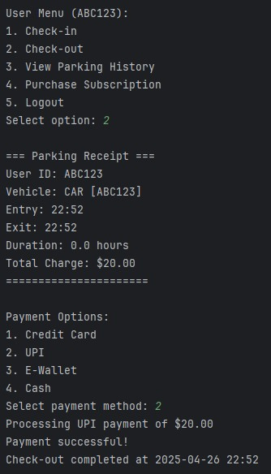
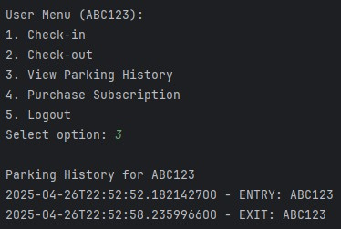
SOME OUTPUT SCREENSHOTS
i
Checking Parking History
Enabling test mode and generating daily report
Check-out of Car

Slide 11
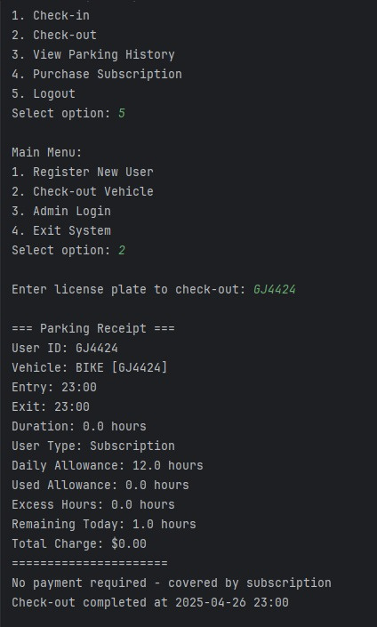
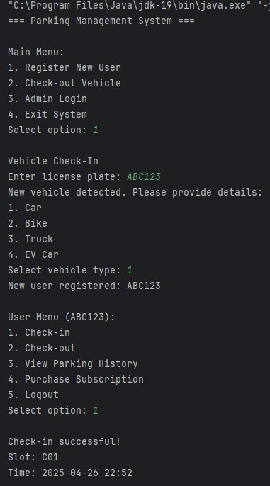
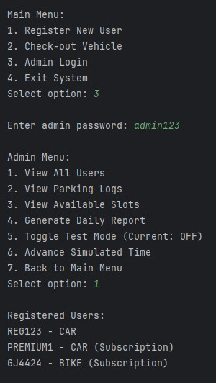
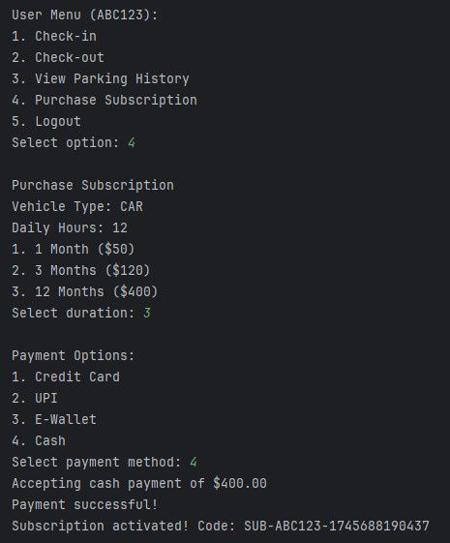
SOME OUTPUT SCREENSHOTS
Admin Menu
Buying Annual Subscription for car
Checking out bike
Check in of new car

Slide 12

Thank You

